Slide 1

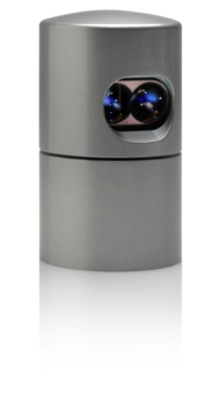
HDL32E Software Version V2.0 Description of New Functionalities and Changes December 4, 2012 (Wolfgang Juchmann)

Slide 2
HDL32E Version 2.0 Software Overview
New Features:
WebServer with GUI and API
Calibrated Reflectivity Values
Zero Horizontal Angle Calibration
Improved GPS and Timestamp Handling
Noticeable changes to previous Software (V1.0):
Default IP address now 192.168.1.201 (changeable via WebServer)
Intensity now represents 256 calibrated reflectivity values (not 11 laser powers)

Slide 3
Noticeable changes to Version 1.0
Default IP address is now 192.168.1.201
With the introduction of the WebServer functionality with Version 2.0, the IP addresses as well as the Gateway and Network addresses can now be configured by the user. Therefore there is no need to ship HDL32E with different IP address, but all of them will be shipped with the default address 192.168.1.201.
Intensity now represents 256 calibrated reflectivity values (not 11 laser powers)
As a result of better differentiation between diffuse reflectors and retro-reflectors, diffuse reflectors are now represented with values in the range from 0-100 and retro-reflectors from 101-255.
Depending on the users choice of color scaling, this might result in a shift of colors from what the user is used to. Adjustment of color scaling corresponding with the definition for diffuse and retro-reflectors in Version 2.0 will help with better differentiation for the reported calibration values.

Slide 4
HDL32E V2.0 WebServer Functionality November 30, 2012 (Wolfgang Juchmann)

Slide 5
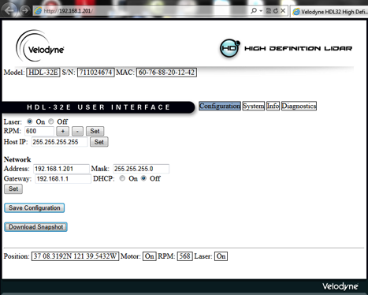
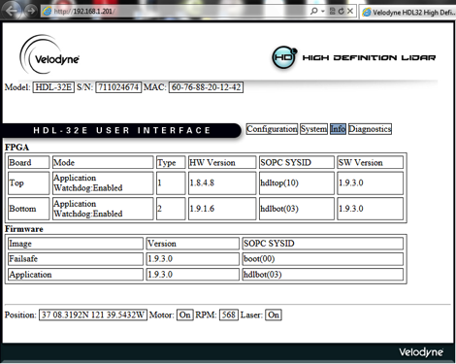
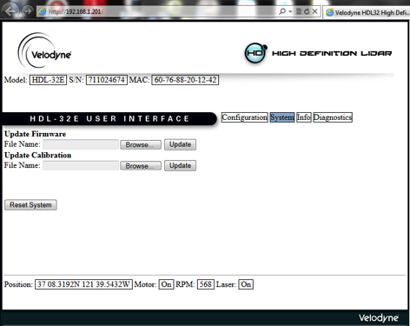
WebServer with GUI and API
The HDL32E now contains a WebServer that allows the user to monitor configuration parameters, choose network settings, control rotational speed and upload new firmware and/or calibration files
The WebServer can be accessed by a GUI using Internet Explorer (other browsers are mostly compatible but have small issues with the live update portion of the GUI) or by issuing “JSON” commands and receiving “XML” style returns via a computer
JSON Commands:
http://<hdl-ip-addr>/cgi/settings.json
http://<hdl-ip-addr>/cgi/status.json
http://<hdl-ip-addr>/cgi/info.json
http://<hdl-ip-addr>/cgi/diag.json
with default <hdl-ip-addr> = 192.168.1.201

Slide 6
How to use WebServer
Plug Ethernet cable into Host Computer
Disable all other Internet / Ethernet / Wireless connections
Plug GPS into HDL32E adapter box (optional)
Plug Power into HDL32E adapter box
after 5-8 seconds the HDL32E should start spinning
Open Internet Explorer browser
other browsers might work but are not supported at this time
Type in IP address of HDL32E sensor:
Default: http://192.168.1.201
Internet Explorer will show HDL32 WebServer screens
The “Download Snapshot” button on the Configuration Screen allows for recording of all configuration parameters at once in a text based (xml) file.

Slide 7
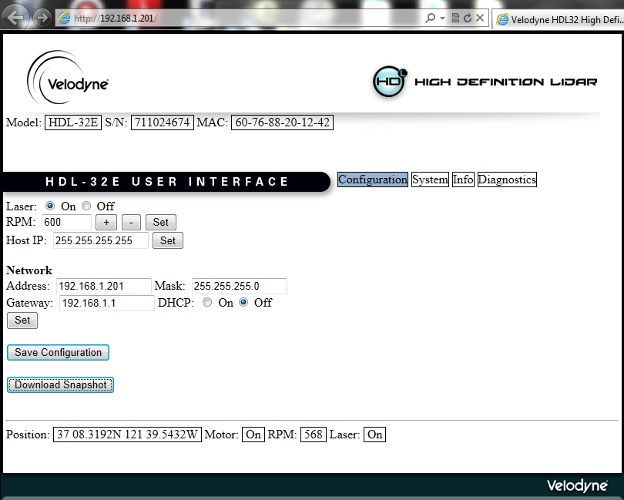
Settings and Status
Default <hdl-ip-addr> : 192.168.1.201
Settings (settings.json)
curl -s http://<hdl-ip-addr>/cgi/settings.json | python -mjson.tool
{
"laser":"On",
"rpm":600,
"host”:{
"addr":"255.255.255.255”
},
"net”{
"addr":"192.168.1.201",
"mask":"255.255.255.0",
"gateway":"192.168.1.1",
"dhcp":"Off”
}
}
Status (status.json)
curl -s http://<hdl-ip-addr>/cgi/status.json | python -mjson.tool
{
"gps":{
"position":“37 08.3192N 121 39.5432W “
},
"motor“:
"state":"On",
"rpm":742
},
"laser":{
"state":"On“
}
}
Variable | Type | Description | Typicial/Default | Range | Rules/Comments
Laser | Set and Read | Provides power to upper board and turns lasers on/off | ON | ON or OFF | If Laser is OFF, there will be no distance packets.
RPM | Set | selects the approx. motor speed in rotations per minutes | 600 | 0 and 300-1200 | Allowed values: 300-1200 RPM. Values outside this range are truncated. Setting “0” will disable rotation and lasing. Actual RPM read value is scaled and may not equal RPM exactly. Do not set RPM’s that result in >1200 actual RPMs
Host IP | Set and Read | chooses/shows Host IP address of computer controlling sensor | 255.255.255.255
Network Address | Set and Read | chooses/shows Network IP address of sensor | 192.168.1.201 | IP address format | none
Network Mask | Set and Read | chooses/shows Network Mask of sensor | 255.255.255.0 | IP mask format | none
Network Gateway | Set and Read | chooses/shows Network Gateway of sensor | 192.168.1.1 | IP gateway format | none
Network DHCP | Set and Read | selects DHCP of sensor as ON or OFF | OFF | n/a | none
SET Button | Set | activates the Network settings after changes | Press Button | n/a | none
SAVE Config | Set | saves all settings on this page into sensor after changes | Press Button | n/a | All values take effect immediately, but are not saved over power cycle until save config button has been pressed.
Download Snapshot | Read | Saves all internal configuration parameters into HDLxxxSNxxx.hdl file | Press Button | n/a | none

Slide 8
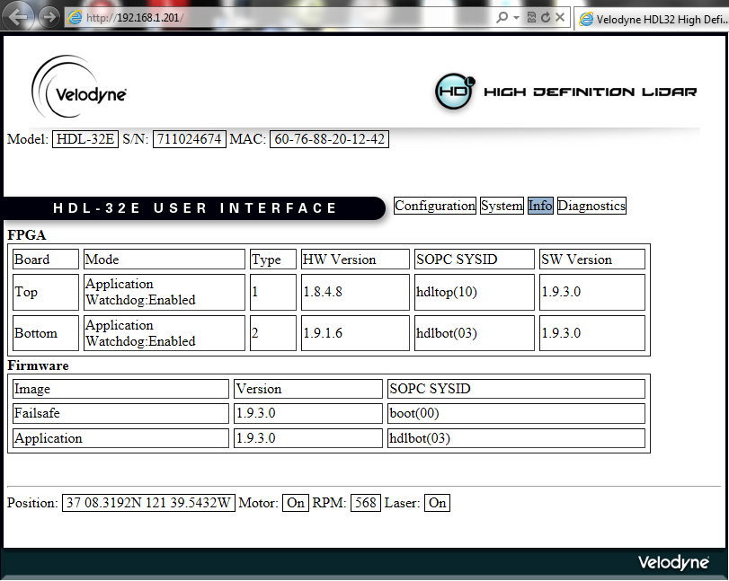
Information
Information (info.json)
curl -s http://<hdl-ip-addr>/cgi/info.json | python -mjson.tool
{
"model":"HDL-32E",
"serial":"711024674",
“mac_addr":"60-76-88-20-12-42",
“image":{
"failsafe":{
"signature":2779096485,
"version":17367808,
"timestamp":1348862775,
"data_length":293836,
"data_crc":4045072806,
"res1":1212435456,
"res2":1343364855,
"header_crc":3114870981
},
"application":{
"signature":2779096485,
"version":17367808,
"timestamp":1352183794,
"data_length":364496,
"data_crc":3862843394,
"res1":1212435459,
"res2":1351184552,
"header_crc":3972623176
}
},
"sysid":{
"bot":{
"id":1212435459,
"timestamp":1351184552
},
"top":{
"id":1145588752,
"timestamp":1343356599
}
},
"state":{
"bot":{
"factorymode":0,
"powerup":0,
"runconfig":0,
"wdtimer":0,
"nstatus":0,
"crcerr":0,
"nconfig":0,
"appmode":1,
"wden":1,
"prevaddr":0,
"appaddr":16777216,
"wdto":118489096
},
"top":{
"factorymode":0,
"powerup":0,
"runconfig":0,
"wdtimer":0,
"nstatus":0,
"crcerr":0,
"nconfig":0,
"appmode":1,
"wden":1,
"prevaddr":0,
"appaddr":917504,
"wdto":262144008
}
},
"fpgaid":{
"bot":{
"id":2,
"version":17367302,
"timestamp":0
},
"top":{
"id":1,
"version":17302536,”
timestamp":0
}
},
"appid":{
"bot":{
"type":2,
"version":17367808,
"timestamp":1352183659
},
”top":{
"type":1,
"version":17367808,
"timestamp":1348862211
}
}
}
This screen shows which Hardware and Software versions are being used in the sensor
It also shows if the sensor has been switched from an application to a failsafe mode
API displays software versions as numerical values that can be converted to version format
17367302 = 0x01090106 => 0x01 09 01 06 > 1.9.1.6

Slide 9
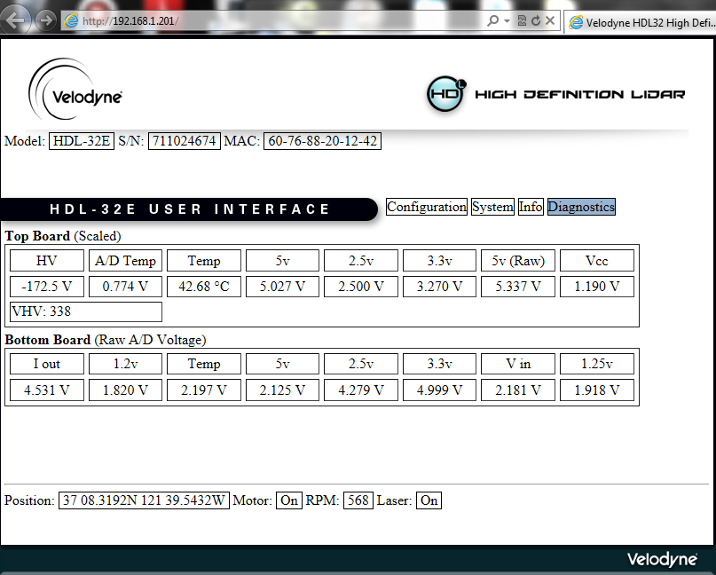
Diagnostics
Diagnostics (diag.json)
curl -s http://<hdl-ip-addr>/cgi/diag.json | python -mjson.tool
{
"volt_temp":{
"bot”:{
"i_out":3719,
"pwr_1_2v":1489,
"lm20_temp":1800,
"pwr_5v":1743,
"pwr_2_5v":3519,
"pwr_3_3v":4095,
"pwr_v_in":1785,
"pwr_1_25v":1583
},
"top":{
"hv":2657,
"ad_temp":629,
"lm20_temp":1086,
"pwr_5v":2063,
"pwr_2_5v":2049,
"pwr_3_3v":2681,
"pwr_5v_raw":2183,
"pwr_vccint":976
}
},
"vhv":363
}
This screen is for factory diagnostics purposes.
Values are not calibrated and only have limited meaning

Slide 10
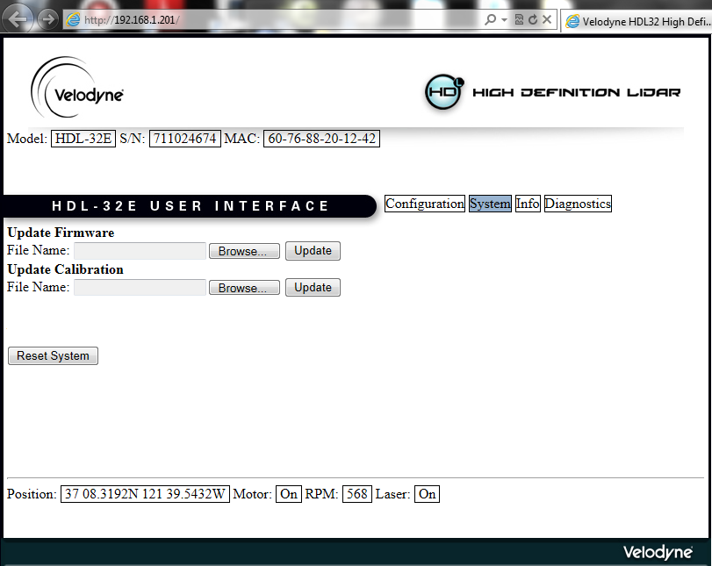
System
Variable | Type | Description | Typical/Default | Range | Rules/Comments
Model | Read | shows model number | HDL-32E | HDL-32 versions | none
SN | Read | shows unique Serial Number | 711024674 | 9 digit number | none
MAC | Read | shows unique MAC address | 60-76-88-20-12-42 | 12 digit MAC format | none
Configuration | Set and Read | selects Configuration screen | white or blue when selected | white,blue | only one screen selected
System | Set and Read | selects Diagnostics screen | white or blue when selected | white,blue | only one screen selected
Info | Set and Read | selects Info screen | white or blue when selected | white,blue | only one screen selected
Diagnostics | Set and Read | selects Diagnostics screen | white or blue when selected | white,blue | only one screen selected
Update Firmware | Set | allows new firmware upload | yyyyy.flash | n/a | n/a (only upload factory recommended firmware updates)
Update Calibration | Set | allows new calibration upload | xxxxx.srec | n/a | n/a (careful with uploading the wrong calibration file)
Reset System | Set | restarts processors to a fresh power on state | n/a | n/a | takes about 30 seconds
Position | Read | shows GPS position if connected | 37 08.3027N 121 39.5421W | n/a | none
Motor | Read | Shows motor status | ON | ON or DISABLED | Lasers will be disabled when rotations are below 200 RPM’s
RPM | Read | shows actual measured rotations per minutes | 600 | 0 - 3000 | RPM actual read value does have an offset to set value, since there is no feedback loop connecting set and read value. Do not set RPM;s that result in > 1200 RPM measured
Laser | Read | shows if laser is ON or DISABLED | ON | ON or DISABLED | Laser turns OFF when measured motor speed is less than 200 RPM’s

Slide 11
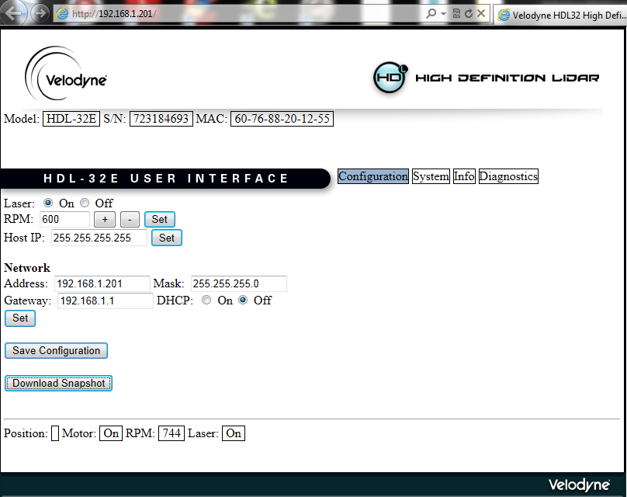
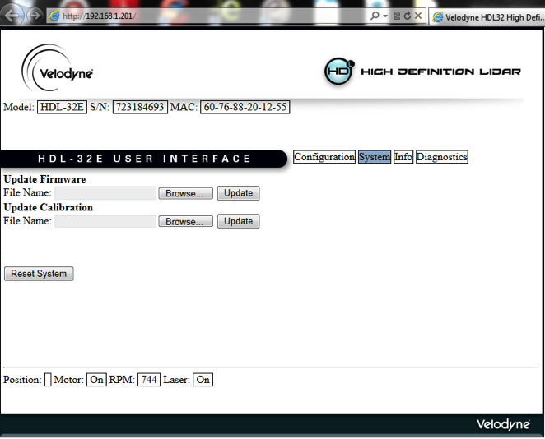
Firmware Upload Procedure
This procedure should only be performed if instructed by Velodyne to upload a new firmware version.
Establish communication via internet explorer and the IP address
Default: https://192.168.1.201
For backup purposes, press Download Snapshot and save file
HDL<sensor serial number>.hdl
Switch to Systems page

Slide 12
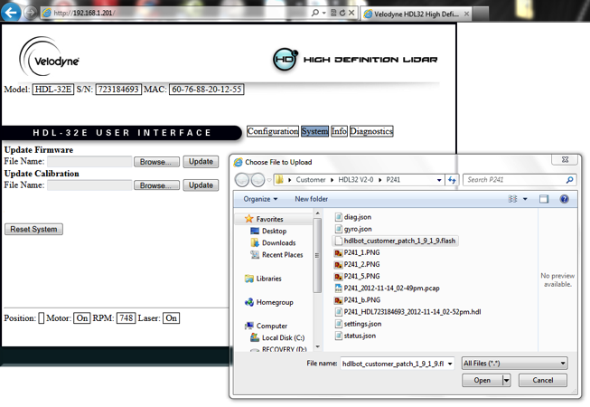
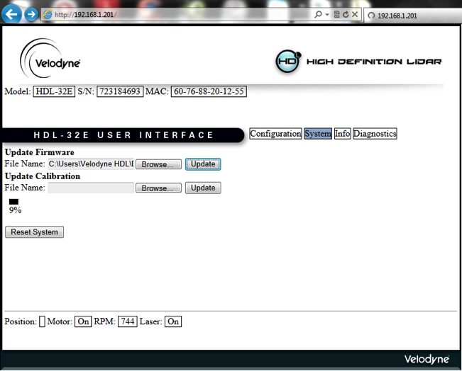
Firmware Upload Procedure
Click Browse and locate firmware to be uploaded
xxxx.flash format
Click Open and see file path in window
Click Update and notice progress status (next slide

Slide 13
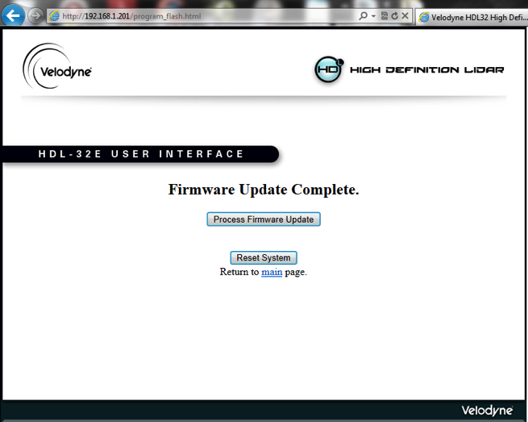
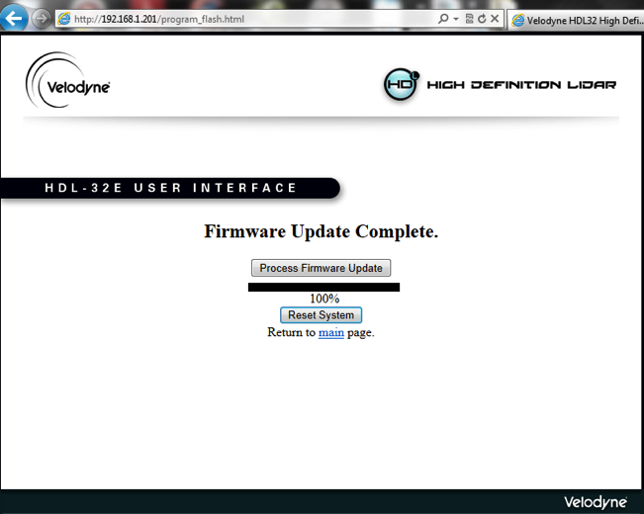
Firmware Upload Procedure
Once uploaded the following window will open
Press Process Firmware Update
Monitor Progress status
Once 100% has been reached, press reset system
Main Page will appear again after reset (next slide)

Slide 14
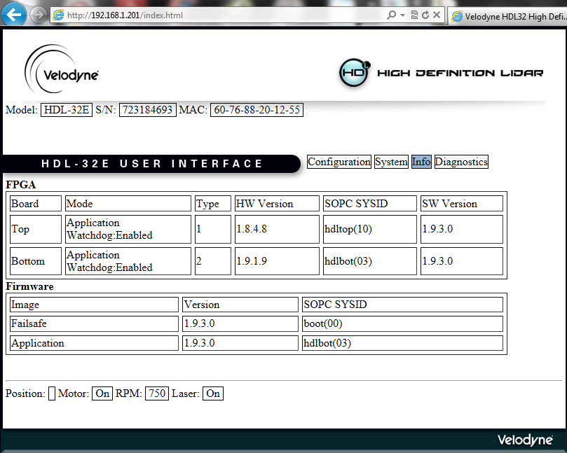
Firmware Upload Procedure
Press Download Snapshot to safe configuration after upload
Change to Info screen to see new versions of software
API displays software versions as numerical values that can be converted to version format
17367302 = 0x01090106 => 0x01 09 01 06 > 1.9.1.6

Slide 15
HDL32E: V2.0 Calibrated Reflectivity November 30, 2012 (Wolfgang Juchmann)

Slide 16
Calibrated Reflectivity Value (Version 2.0)
Version 1.0 of the HDL32E reports in the data packages the measured distance as well as a value labeled intensity. The reported intensity value is based on one of 11 laser powers that the sensor has dynamically chosen based on best signal to noise ratio on the detector for the previous shot form that laser.
Low reflectivity targets generate small signal and a high laser power is chosen and reported.
High reflectivity targets report a high signal and a low laser power is chosen and reported.
Therefore in V1.0 the reported laser power values are an inverse measure of the reflectivity.
Version 2.0 of the HDL32 measures the true reflectivity of a target independent of laser power and distance with true 256bit resolution.
Diffuse reflectors report values from 0 to 100 for 0-100% reflectivity
Retro-reflectors report values from 101 to 255 with 255 being the reported reflectivity for an ideal retro-reflector and 101 – 254 being the reported reflectivity for partially obstructed retro-reflectors or imperfect retro-reflectors.
The HDL32E is calibrated using commercially available reflectivity standards.
A ~95 m test range allows for accurate calibration of reflectivity values independent of distance.
As a result of better differentiation between diffuse reflectors and retro-reflectors, diffuse reflectors are now represented with values in the range from 0-100 and retro-reflectors from 101-255.
Distances of < 0.5 m and from beyond the detection range are reported as zero meters.
Depending on the users choice of color scaling, this might result in a shift of colors from what the user is used to. Adjustment of color scaling corresponding with the definition for diffuse and retro-reflectors in Version 2.0 will help with better differentiation for the reported calibration values.
A customer reported error were retro-reflectors “plume” out and form a “cloud” or “ghost image” in front of or behind their exact location has been fixed.

Slide 17
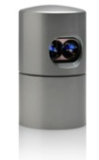

HDL32E: Intensity Data
Intensity data output format the same as previously (8 bit, 0-255 values)
value 0 – value 100 = 0 – 100% reflectivity from diffuse surface
value zero means 0% reflectivity, which means that 0% of light is reflected back to the sensor (black, absorbent surface)
value 100 means 100% reflectivity, which means that 100% of light is reflected (white, highly reflective surface) into many directions of which a small angle is captured by the sensor
a)
black, absorbent diffuse reflector
(value 0)
b)
white, reflective diffuse reflector
(value 100)
Values higher than 100% reflectivity are possible, if the surface is not a diffuse surface but a highly reflective surface like a retro-reflector
Anything higher than 100% is defined as a partial reflection from a high reflector
Value 101 – 255 = partial reflection from retro-reflector
value 101 means reflection is almost the same as white, reflective diffuse reflector (b) plus small amount of reflection from the retro-reflector
value 255 means ideal reflection of the retro-reflector (perfectly clean retro-reflector, no coverage)
c)
retro-reflector covered with semi-transparent white surface
(value 101)
d)
retro-reflector without any coverage
(value 255)
- 17 -

Slide 18
HDL32E V2.0 Zero Angle Calibration November 30, 2012 (Wolfgang Juchmann)

Slide 19
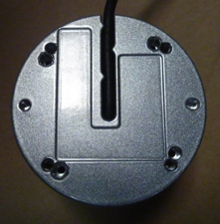
Zero Angle Calibration (Version 2.0)
Zero Horizontal Angle Calibration
The HDL32E provides two holes on the bottom side for precision mounting using dowel pins. In order to reproduce unit to unit reproducibility the zero angle (for the rotational axis) is calibrated with respect to the dowel pins.
Previously the the zero angle accuracy was limited by manufacturing and assembly tolerances of several rotational assemblies, while with Version 2.0 the zero angle is calibrated to the dowel pin holes after the assembly providing much better unit to unit repeatability.
The target is centered to the mounting holes for dowel pins which are permanently fixed to the floor
Several scans of laser 15 (horizontal) across the target are used to determine the center position from the edge locations
The accuracy of the calibrated zero angle is about 0.05 degrees
The unit to unit repeatability has additionally been increased with Version 2.0 by not coating the bottom side of the HDL32E sensor, thereby avoiding inaccuracies for mounting introduced by non-uniform coatings.
Dowel Pin hole
Dowel Pin slot
Silver coating has been removed from bottom side with version 2.0

Slide 20
New Features of Version 2.0
GPS Fix
Customer had reported problems with the $GPRMC sentence related to the timing after a full second and also with some missing characters. Both problems have been fixed in Version 2.0
Timestamp Fix
Customers had reported problems with the timestamps “jumping” around especially after full hours. This problem has been fixed with Version 2.0

